Slide 1
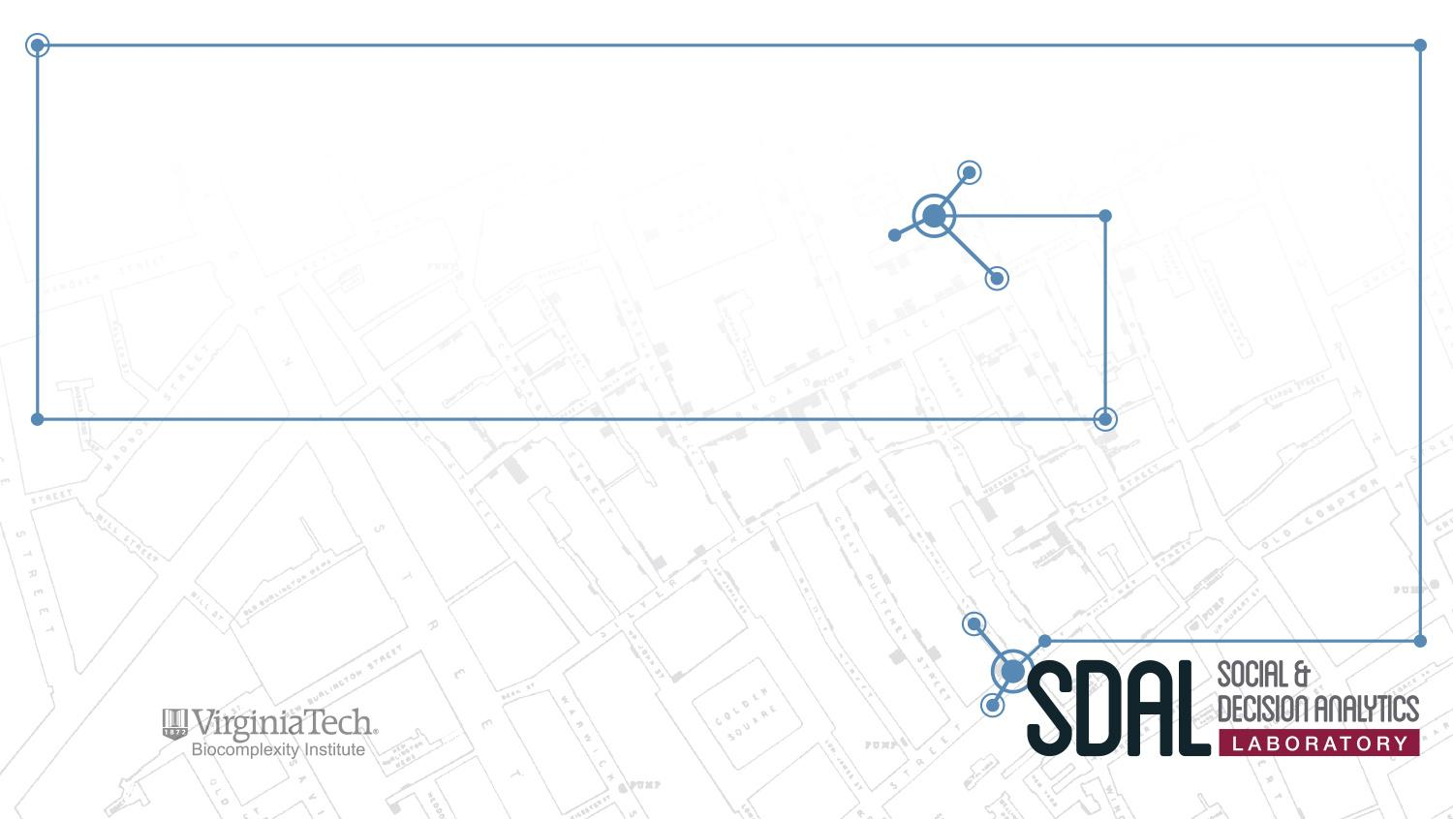
DSPG 2017 Project Descriptions

Slide 2
Outline
DSPG Group Project – Community Profiles & Indicators
Alexandria
Arlington
Fairfax
New Kent
Roanoke
NSF NCSES Projects
Open Source Software (OSS)
Business Innovation
STEM Education
Army Research Institute (ARI)
State Council of Higher Education for Virginia (SCHEV)
Washington Metropolitan Area Transit (WMATA) Project
Arlington County Projects
Public Safety 911: Police and Fire Departments (AC 911)
Department of Human Services (DHS)
The Beach

Slide 3

Group Project: Community Profiles and Composite Indicators
PI & Co-PIs: Vicki Lancaster & Aaron Schroeder & Dave Higdon
Team: Everyone!
Sponsor: Virginia Cooperative Extension Service

Slide 4
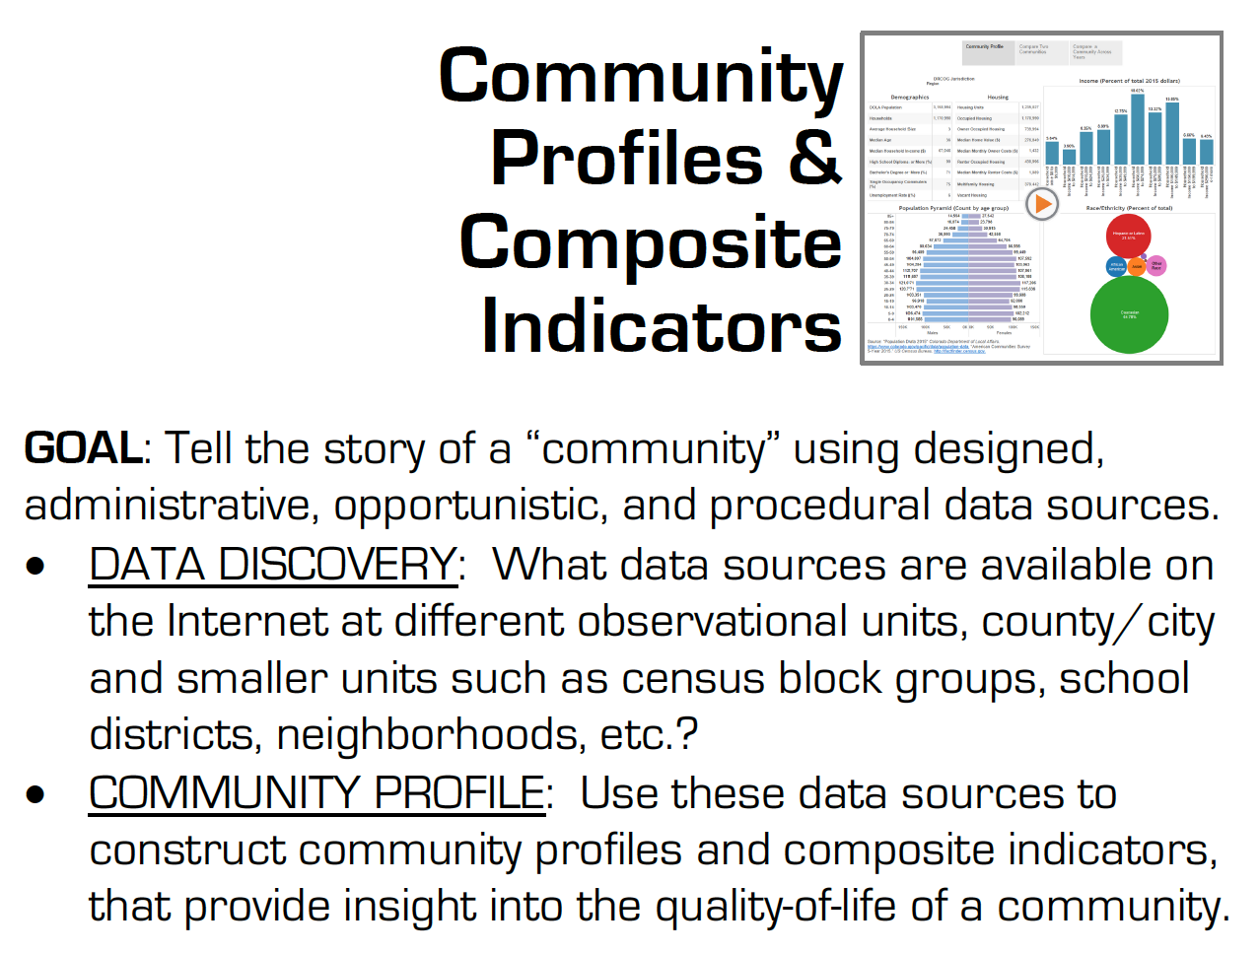

Slide 5
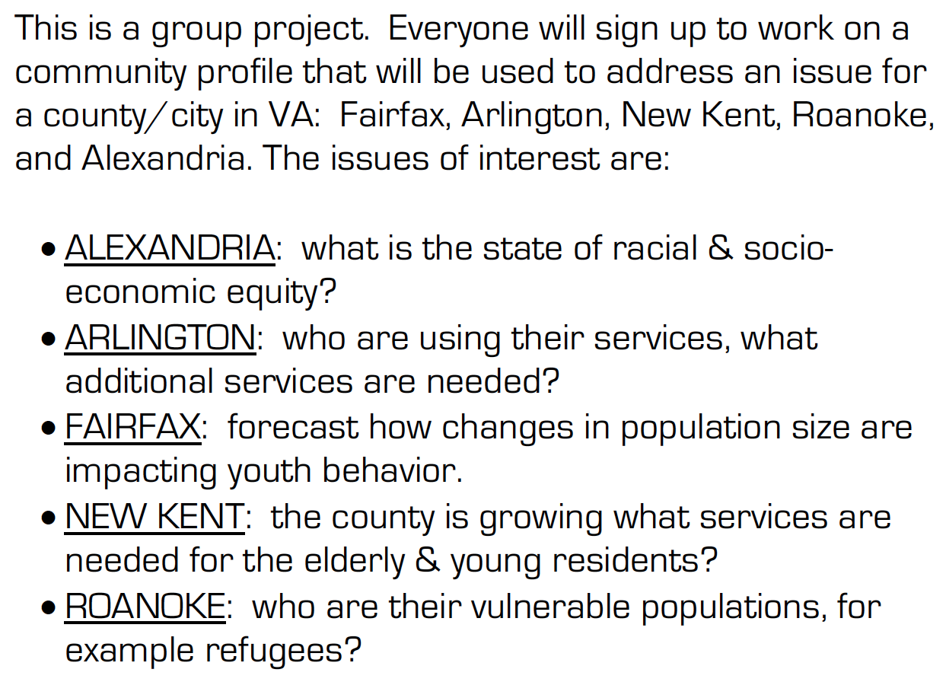

Slide 6
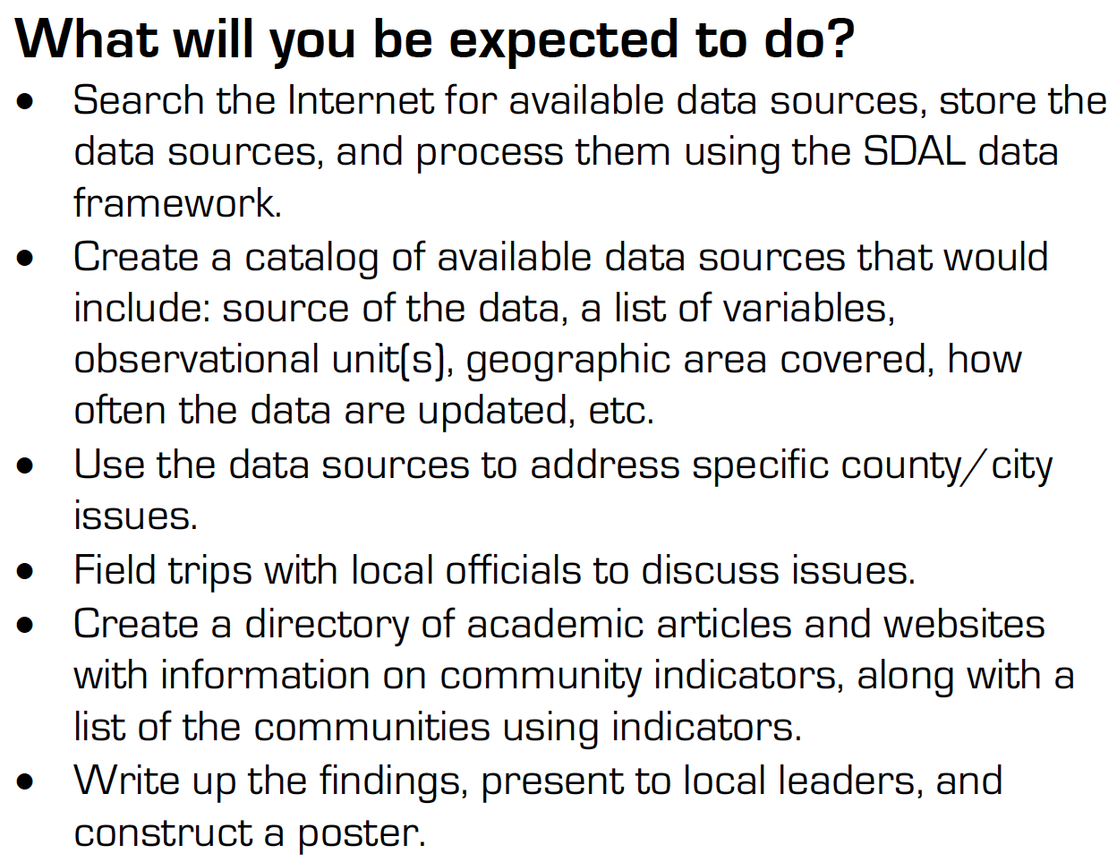

Slide 7
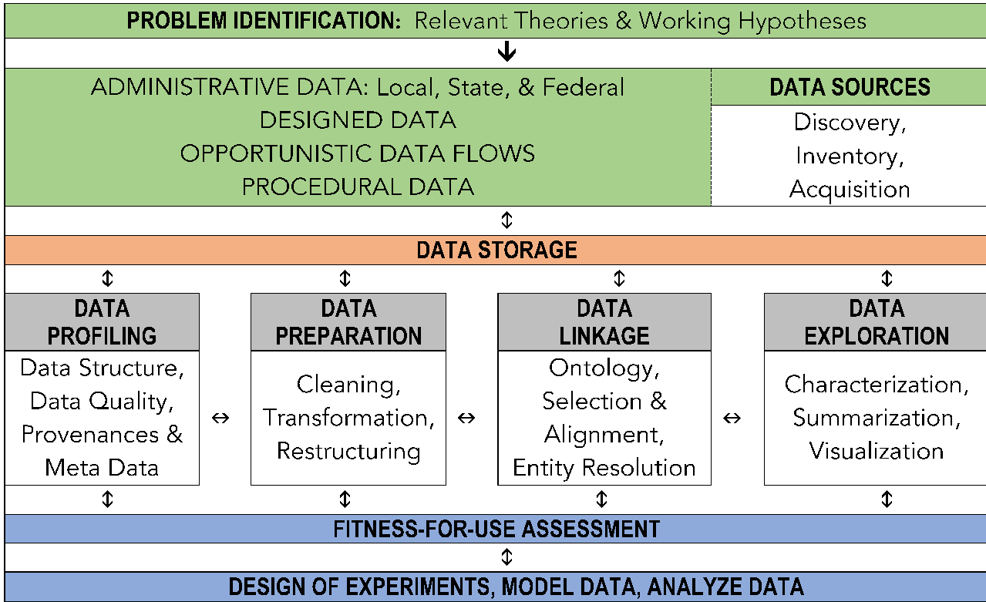
SDAL Data Framework
Notes:
The Data Model consists of the following high-level steps:
Data source discovery and acquisition, primarily identifying and obtaining internal data for use in the modeling.
Data profiling to understand and describe the data.
Data cleaning and restructuring for analysis.
Data linkages to understand the relationships between variables and tables.
Data Exploration including visualization, generation of descriptive statistics, and analysis of patterns and inconsistencies in the data.
The data fitness assessment will evaluate available data sources for issues of completeness, value validity, consistency, uniqueness, duplication, as well as issues of data structure. The results of these analyses will help determine what necessary transformations/cleaning might be needed as well as the fitness of the data for use in further analysis.
The data integration and statistical analysis will produce longitudinal profiles of the county by relevant geographic areas (e.g., high-school boundaries, supervisor areas) and relevant to the research questions. These findings will inform the construction of forecast models.

Slide 8

Equity in Alexandria
PI & Co-PI: Emily Molfino & Stephanie Shipp
Team: Vicki Lancaster, Mark Orr
Sponsor: City of Alexandria, Office of Performance and Accountability

Slide 9
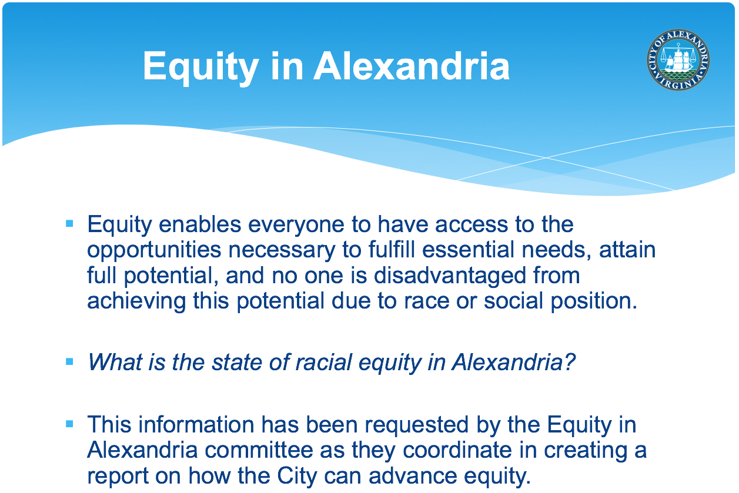

Slide 10
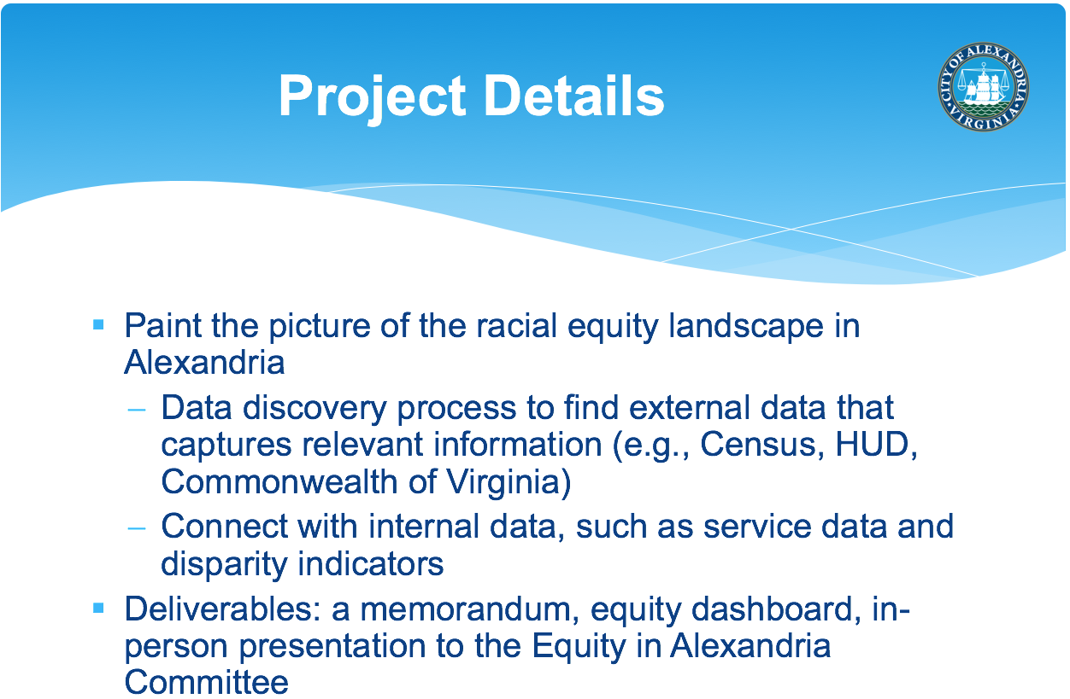

Slide 11

Needs Assessment in Arlington
PI & Co-PI: Vicki Lancaster & Stephanie Shipp
Sponsor: Arlington Partnership for Affordable Housing (APAH)

Slide 12
Research Questions
The following questions will help direct the data discovery process – needs assessment for various populations:
What childcare services are available to low income residents for children ages 0-5 years?
What summer childcare services are there for low income families?
What do low income middle school children go after school, what programs are available to them?
What library services would better serve the elderly and immigrant populations?

Slide 13

Identifying and Predicting Effects of Trends on Youth Population in Fairfax County
PI & Co-PI: Stephanie Shipp & Vicki Lancaster
Team: Gizem Korkmaz, Mark Orr
Sponsor: Fairfax County Division for Countywide Service Integration and Planning Management (CSPIM), Neighborhood and Community Services (NCS), within Health and Human Services (HHS)

Slide 14

Research Questions
Which HHS programs and services may be affected by changes in population size, behaviors, and demographic makeup?
What current and future trends in demographics, housing, and other factors would inform the models to predict changes in their programs?
What are trends in the data that warrant more investigation? e.g., why are kids engaging in less and less physical activity?

Slide 15
Project Goals & Deliverables
Document work on wiki and in short 2-3 page write-ups summarizing results for each activity.
Literature review on youth behaviors under consideration.
Execution of the SDAL data framework to discover, profile, clean, and transform data sets in preparation for data analysis.
Catalog of available data sources that include: source of the data, a list of variables, observational unit(s), geographic area covered, how often the data are updated, etc.
Project findings and the analyses to support the findings.
Outline of future steps to strengthen insights and capabilities for a broader set of population and economic forecasts for Fairfax County HHS programs and activities.
Poster and presentation summarizing the above outputs

Slide 16

Developing a New, Data-Driven project for New Kent County, VA
PI & Co-PI: Aaron Schroeder & Dave Higdon
Team: Vicki Lancaster, Stephanie Shipp
Sponsor: New Kent County Parks & Recreation

Slide 17
Research Questions
New Kent County has a rapidly changing demographic, leading to challenges how the County shepherds and serves its community.
Two problems elicited from earlier meetings are:
There is a perceived increase in the number of teenagers who have “no place to go” after school. Is this leading to an increase in unwanted behaviors with these teens (e.g. drug use, crimes)?
There is a perception that the number of elderly has grown in recent years, but the transportation, recreation, and other amenities for this population is insufficient. If this is the case, what can, or should, be done to better serve this segment of the population?
We would like to work with officials from New Kent County and Virginia Common Extension to
Find and analyze data sources that can improve our knowledge regarding these issues;
Develop potential courses of action, given what we were able to learn from this data.

Slide 18
Project Goals & Deliverables
Document work on wiki and in short 2-3 page write-ups summarizing results for each activity.
Explore life in New Kent County to better understand the population, social dynamics, available activities, etc.
Seek out data sources (some basic, some novel) to aid in our understanding of New Kent County.
Brainstorm potential analyses and interventions that could be carried out to aid understanding.
Profile, clean, and transform data sets in preparation for data analysis.
Work with New Kent Officials to understand this data and develop possible intervention strategies.
Plan out how these new interventions could be assessed for efficacy (e.g. RCT?)
Poster and presentation summarizing the above activities.

Slide 19

Local Characterization of Refugee Social Contexts in Place and Time: Insights from local data sources
PI & Co-PI: Mark Orr & Stephanie Shipp
Team: Bianica Pires
Sponsor: Roanoke

Slide 20


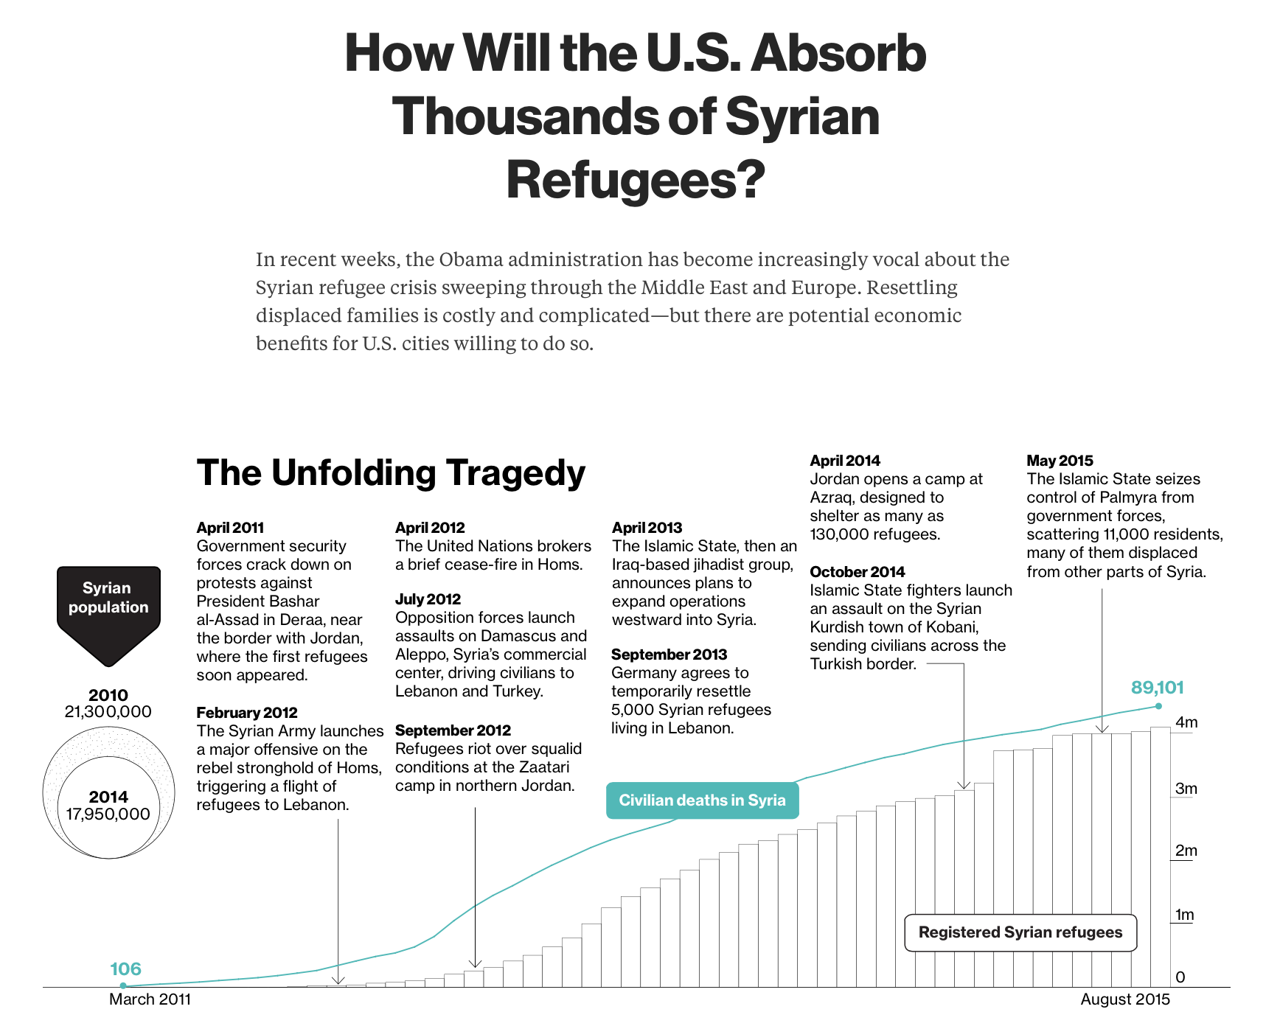
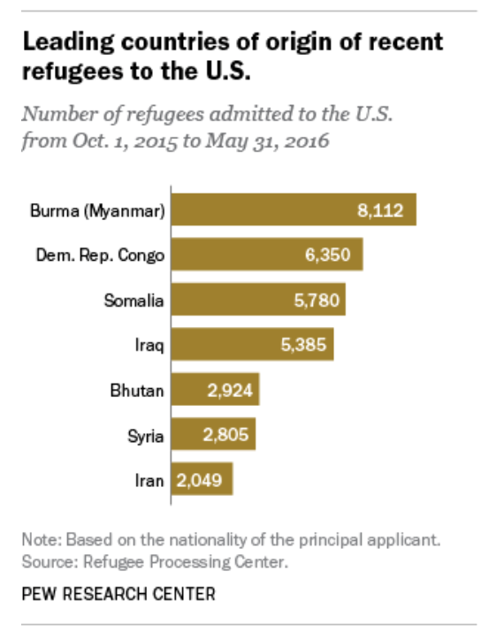

Slide 21
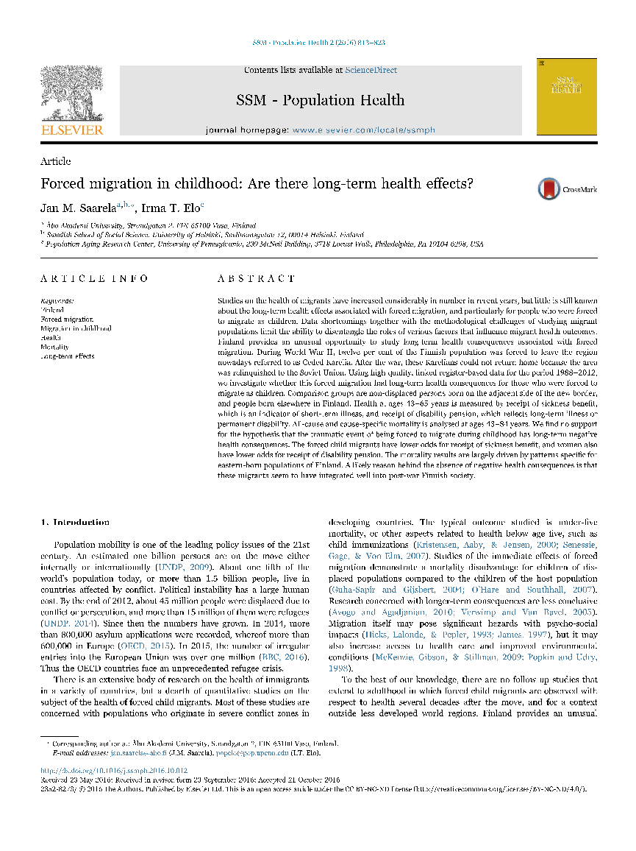
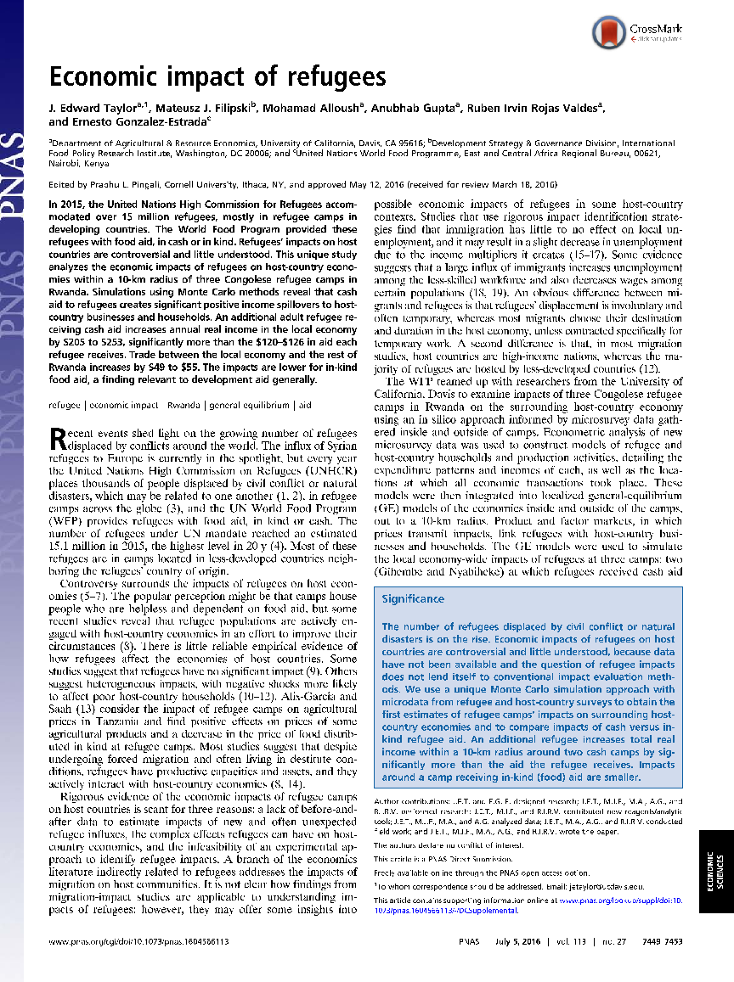

Slide 22
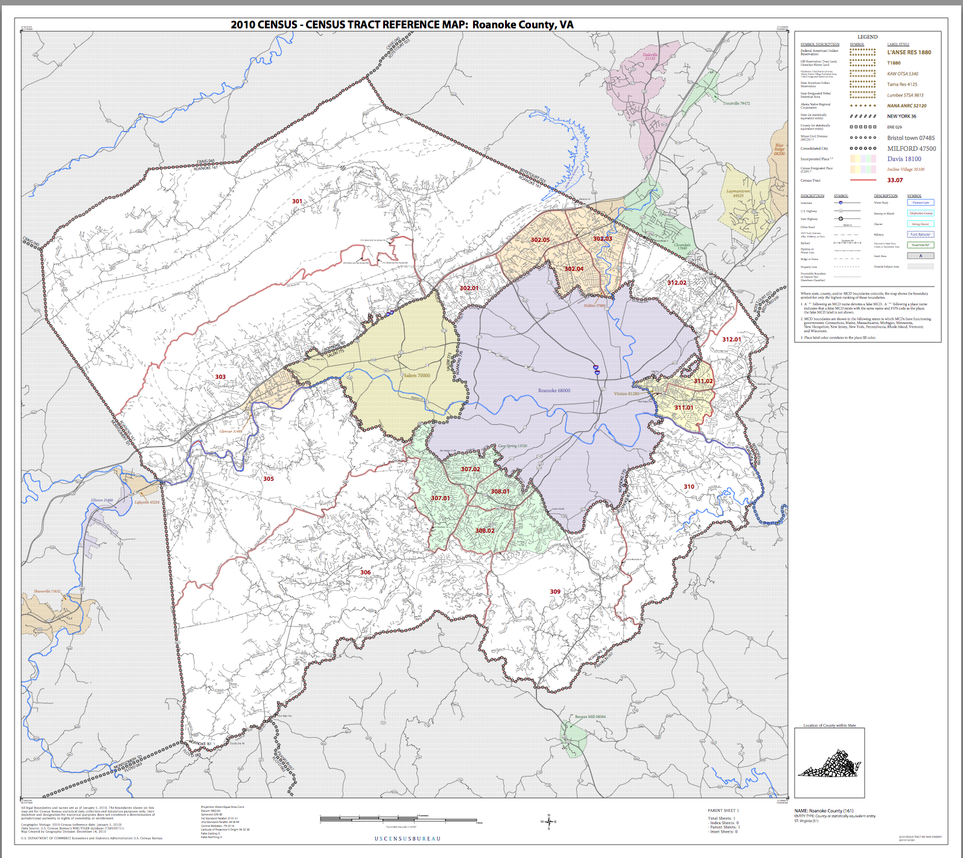
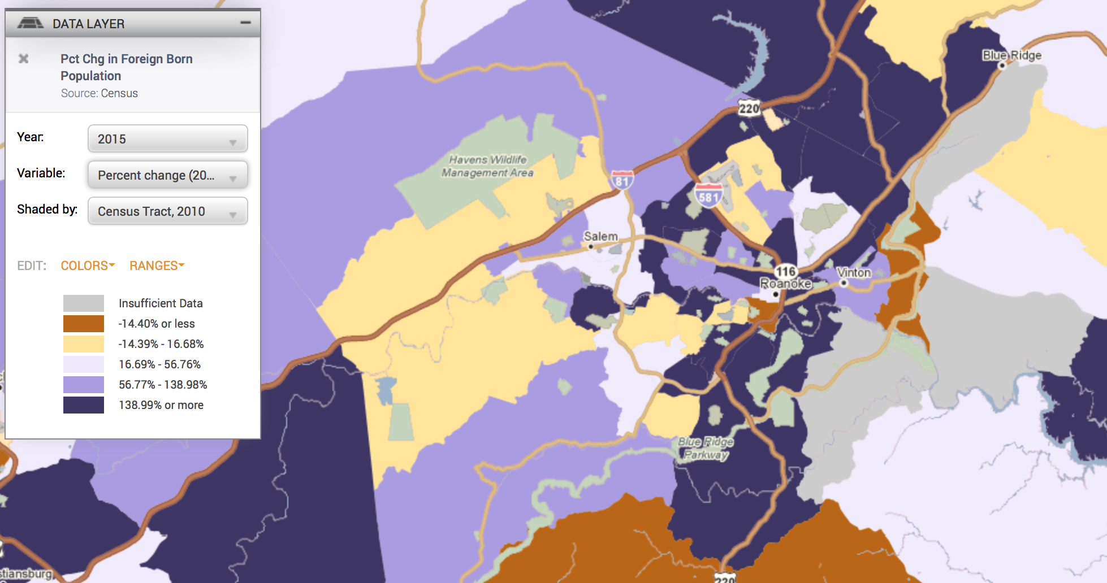
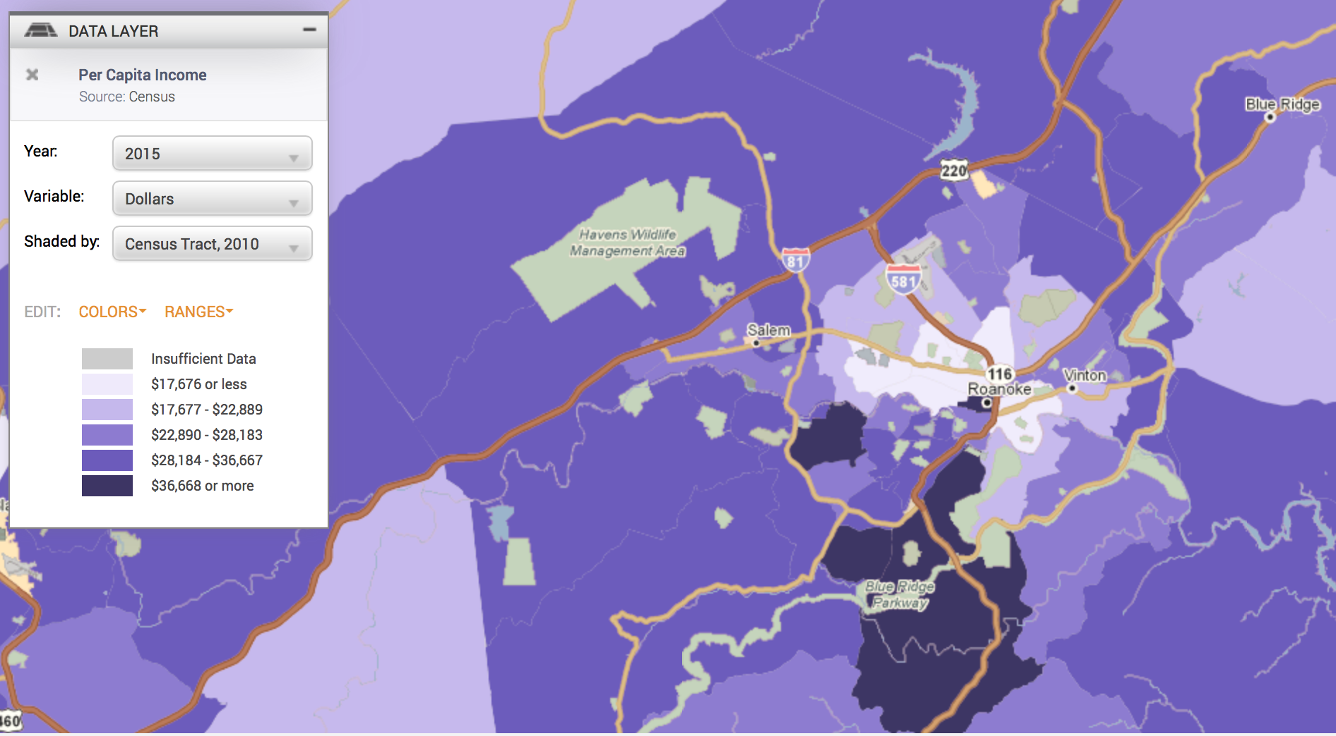
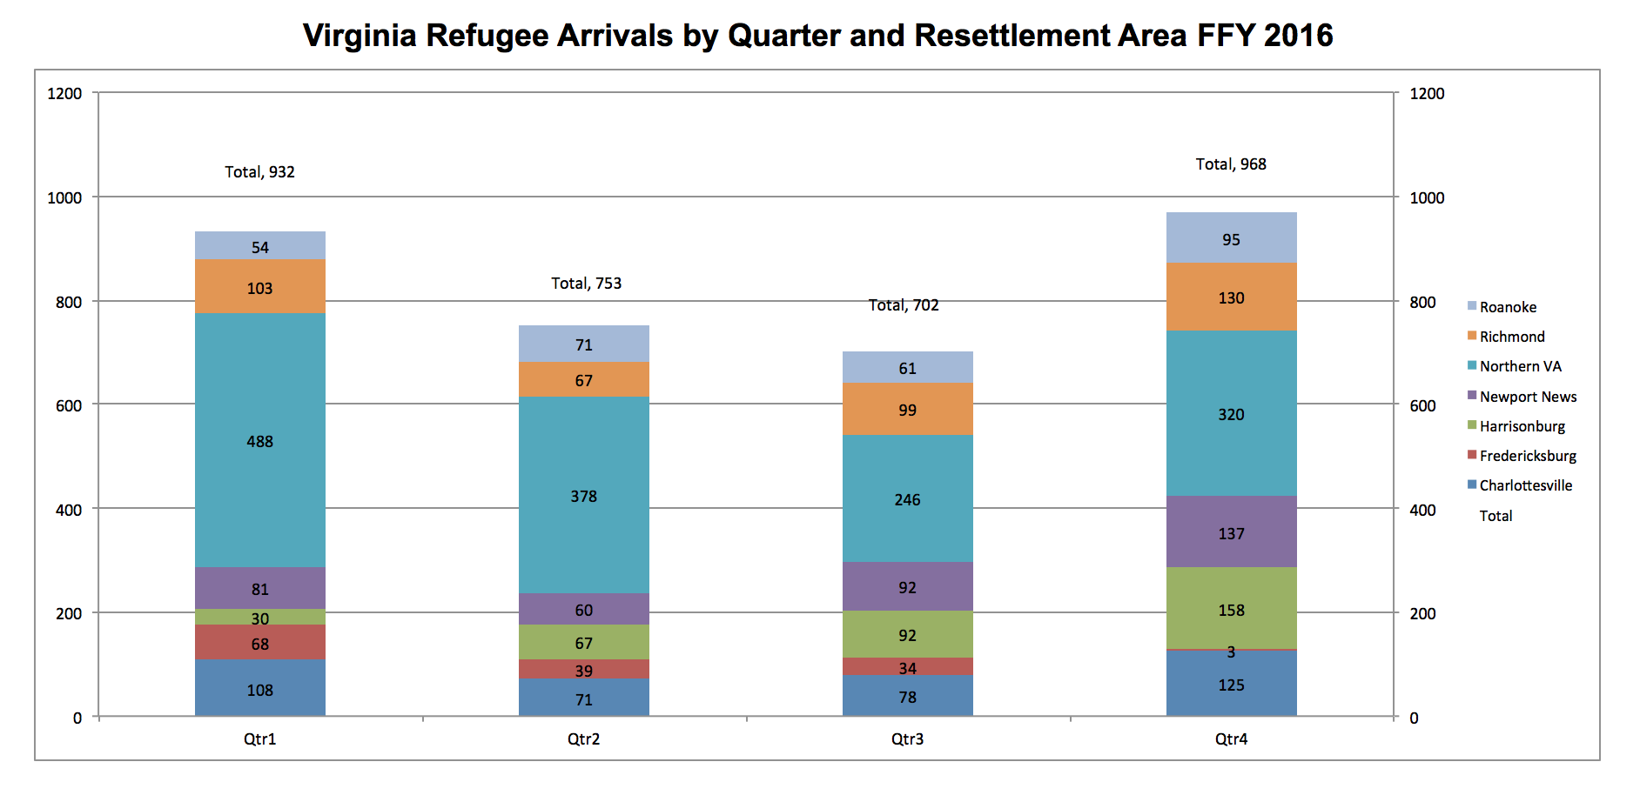

Slide 23
Project Objectives
Issues/Contexts
Across Scales (G → L)
--Substantive
--Methodological/Empirical
--Ethical
--Policy
Data Discovery
--Fed, state, local
--Criminal Justice, economic, education, health, etc.
--All data
Focused
Product
E.G.:
-Provide insight into substantive issue for policy
recommendation
-Solve a technical issue (small n)
-Introduce new and useful data type(s)

Slide 24

NSF National Center for Science and Engineering Statistics (NCSES)
NSF National Center for Science and Engineering Statistics (NCSES) is responsible for the collection, interpretation, analysis, and dissemination of objective data on the science and engineering enterprise. They are responsible for statistical data on:
Research and Development (R&D), and Innovation
The science and engineering workforce
U.S. competitiveness in science, engineering, technology, and R&D
The condition and progress of STEM education in the United States

Slide 25
Measuring the Impact of Open Source Software Innovation
PI & Co-PI: Stephanie Shipp & Gizem Korkmaz
Team: Josh Goldstein
Sponsor: National Science Foundation (NSF) –
National Center for Science and Engineering Statistics (NCSES)

Slide 26
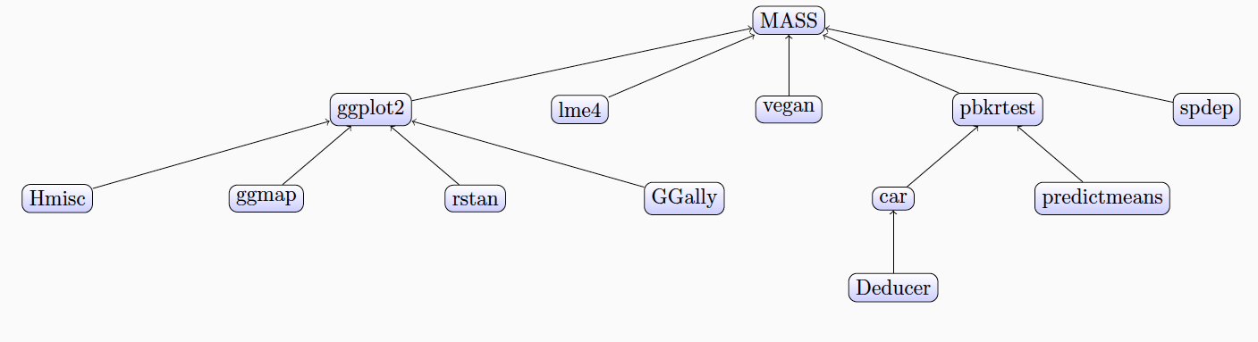
Project Overview
Current NCSES and other economic indicators do not measure the value of goods and services that do not have market transactions,
The goal is to test the feasibility and to develop methods to measure the impact and scope of open source software
Notes:
i.e., they are not captured in surveys nor are in economics measures such as the Gross Domestic Product (GDP).

Slide 27
Research Questions
What sources of data and variables could serve as proxies for measuring attributes and economic value of open source software?
Counts of OSS, by sector, by technology, by cost, by benefits, by geography
Attributes, e.g., # citations, #downloaded, # sectors, etc.
How accessible are these data sources and variables from a repeatability and reliability perspective?
What indicators or models could be created to measure attributes and eventually economic value?
What are gaps or limitations in the proposed approaches?

Slide 28
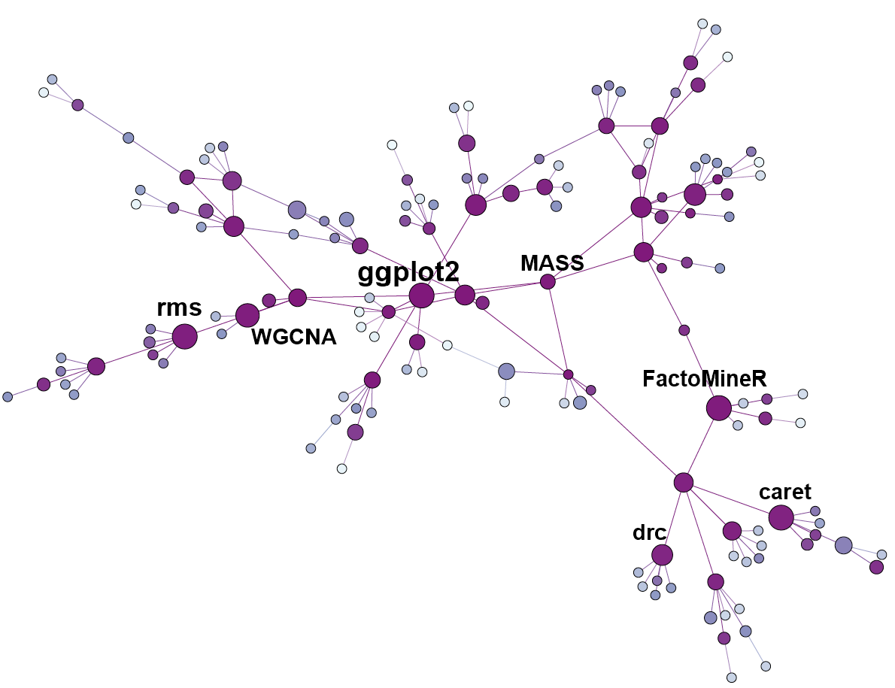
Project Goals & Deliverables
Building on research conducted during Summer 2016, Fall 2016, and Spring 2017
Understanding existing cost/value models for private software
Adapting to open source software
Data collection (webscraping)
Modeling and network analysis

Slide 29
Measuring Business Innovation Using Non-Traditional Data Sources
PI & Co-PI: Gizem Korkmaz & Stephanie Shipp
Team: Bianica Pires
Sponsor: National Science Foundation (NSF) –
National Center for Science and Engineering Statistics (NCSES)

Slide 30
Project Overview
Current practice to measure business innovation is to survey a sample of companies.
This project aims to test the feasibility of developing innovation metrics using non-traditional data sources including product announcements, press releases, and other information obtained through web scraping or queries of selected companies.
Notes:
i.e., they are not captured in surveys nor are in economics measures such as the Gross Domestic Product (GDP).

Slide 31
Research Questions
How do companies measure innovative activities, investments, outputs, and outcomes?
How can opportunity and administrative data be leveraged? What information could be obtained using non-traditional data sources? What methods and models are needed to adapt
What type(s) of innovation (i.e., product, process, marketing, and organizational) could be captured using opportunity and administrative data sources?
Can follow-up interviews with a sample of identified companies be used to confirm and/or contradict the methods and measures?

Slide 32
Project Goals & Deliverables
Review of academic and gray literature: How do companies measure innovation?
Data discovery to identify potential data sources to develop measures of innovation
Data screening and inventory for the selected businesses for discovered data sources; acquire selected data sources through scraping websites, accessing administrative data, etc.
Data quality process – profiling, cleaning, and exploratory analysis of data sources that emerge from the screening and inventory process
Statistical analyses and mappings between types and sources of innovation and data sources

Slide 33
Identifying All (Traditional and Non-traditional) STEM Pathways
PI & Co-PI: Bianica Pires & Stephanie Shipp
Team: Aaron Schroeder & Gizem Korkmaz
Sponsor: National Science Foundation (NSF) –
National Center for Science and Engineering Statistics (NCSES)

Slide 34
Project Overview
NCSES overseas many surveys, such as the Survey of Earned Doctorates, National Survey of College Graduates, Survey of Graduate Students and Postdoctorates in Science and Engineering
Current NCSES reporting does not fully capture the full set of diverse pathways, steps, and outcomes an individual can take to be trained for and enter the STEM (Science Technology Engineering Math) workforce
The goal for this project is to identify pathways and data sources to fill in these gaps
Notes:
STEM fields include computer science, engineering, math and statistics, as well as psychology and the social sciences

Slide 35
Research Questions
What are the education and workforce pathways that lead to a STEM-enabled occupation?, e.g. degrees (AA/BS-BA/MS-MA/PhD/other), online training, certificates, worker training, vocational / apprenticeship training etc.
Other questions of interest
What are STEM pathways for sub-baccalaureate populations? e.g. high school and community college graduates, vocational / apprenticeship training, other.
What are STEM pathways for women and minorities? Where along the pathway do they leave?
Notes:
How do STEM professionals represent themselves? (e.g., when an individual calls himself or herself a Data Scientist, what STEM education, training, and skill sets does that represent?)
How do employers represent their skill set needs?
Is it possible to quantify a job improvement through promotion?
Do non-survey data sources exist to measure STEM pathways, e.g., scraping websites, administrative data, other.
Are there untapped surveys that exist to measure STEM pathways?, e.g. IPEDs?

Slide 36
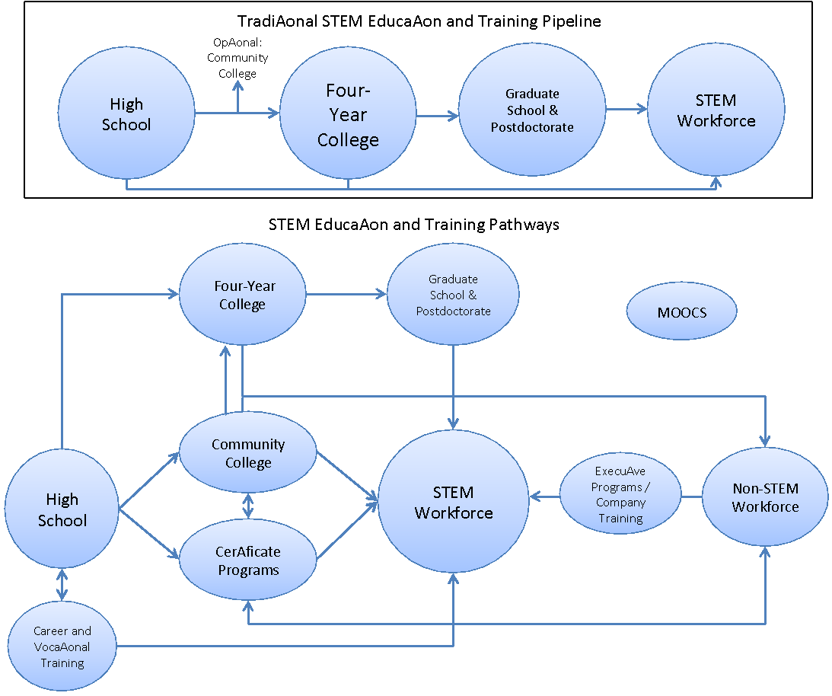
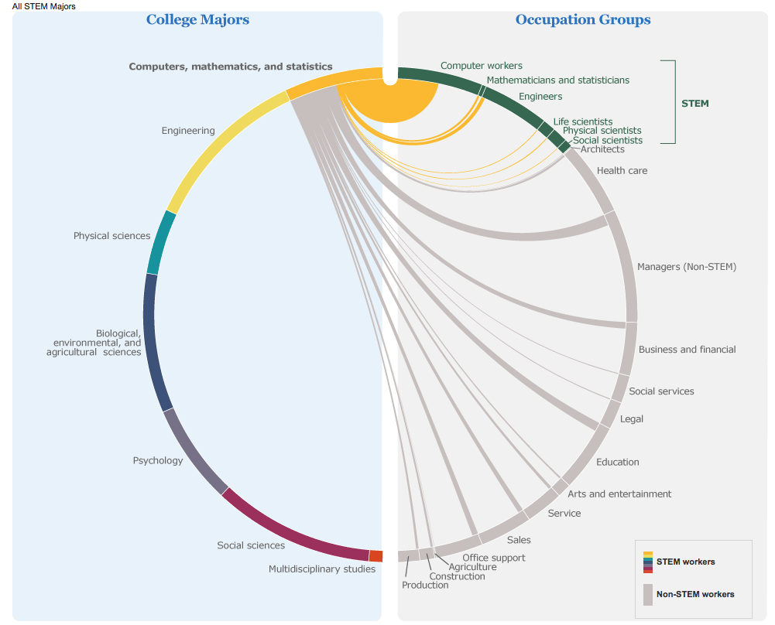
Example Pathways to STEM Workforce
https://www.census.gov/dataviz/visualizations/stem/stem-html/

Slide 37
Project Goals & Deliverables
Conduct literature review on pathways to STEM occupations and how STEM needs are characterized both by the workers and employers
Develop pathways diagram(s) from Education to STEM workforce for 2-3 examples
Conduct data discovery process related to the pathways
Conduct data screening and inventory for discovered data
Use data in analysis to demonstrate STEM pathways for the 2-3 examples

Slide 38
Creating Profiles of Army Bases
PI & Co-PI: Stephanie Shipp & Josh Goldstein
Team: Mark Orr
Sponsor: Army Research Institute (ARI) for
Behavioral and Social Science Research

Slide 39
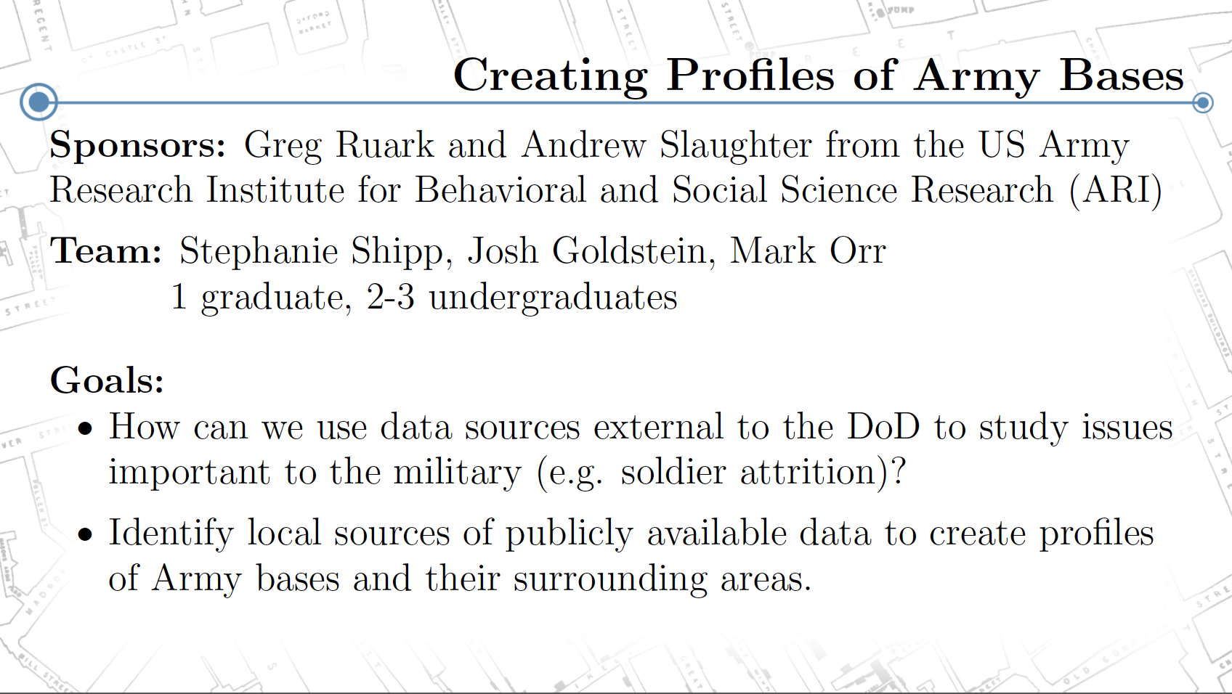
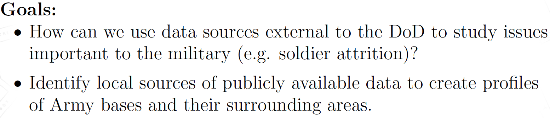

Slide 40
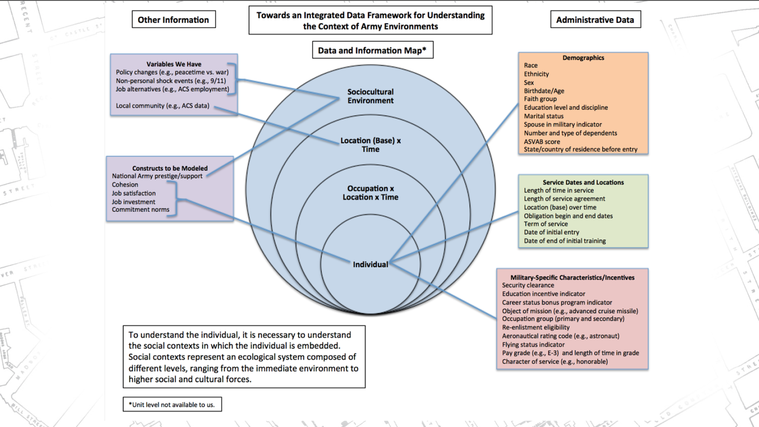

Slide 41
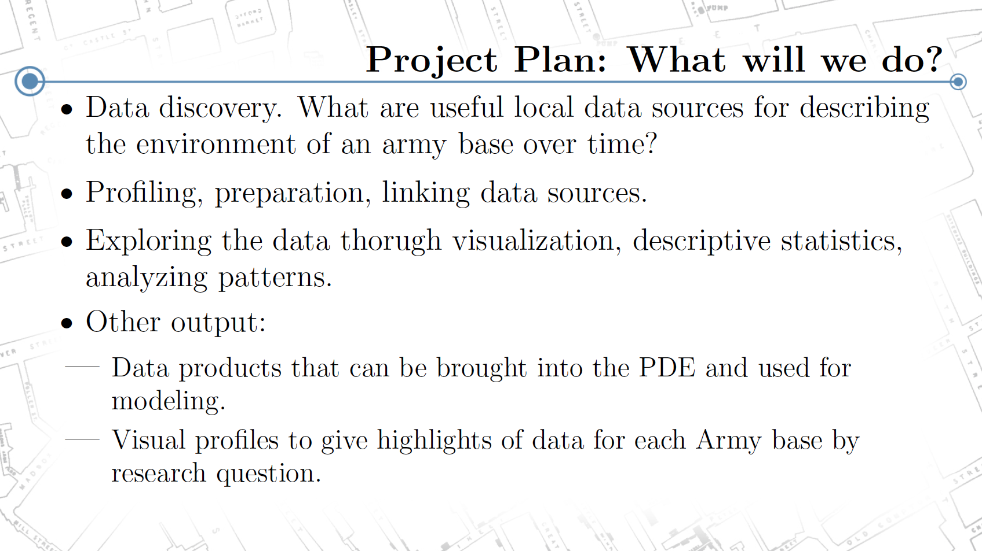

Slide 42


Initial Exploratory Analysis via Machine Learning of Synthetic VLDS data sets for Variable Identification
OR, Figuring Out which Variables are Useful from Large Administrative Data Sets when you are NOT allowed to look at all the data!
PI & Co-PI: Aaron Schroeder & Bianica Pires
Sponsor: State Council of Higher Education for Virginia (SCHEV)

Slide 43
Project Overview
Using administrative data for policy research means identifying which items or collection of items can serve well as proxy variables, both independent and dependent
For example, if we wanted to know an individual's satisfaction-level with a particular situation but we never directly asked that question (i.e. on a survey), we would look instead for alternative data that had been collected (either an individual item or multiple items) that could serve as a proxy for that question (e.g. evidence of increased/decreased participation, number of complaints filed).

Slide 44
Project Overview
When dealing with very wide data sets, sometimes including many 10s if not 100+ items, this can be daunting.
A promising approach is the application of newer "big data" machine-learning algorithms to identify which data items are highly related to each other in some manner
Once these "clusters" have been identified, the researcher can then more easily identify which item(s) can best be used to proxy the needed variable.
However, CAN’T currently do this with VLDS data

Slide 45
Project Overview
Currently, the governance structure and application process for the VLDS do not facilitate exploratory analysis via machine learning
Can’t get “all” of the data - primarily because of need of data providing agencies to understand
how the intended research fits within their broad objective policy categories
whether or not the requested data could actually help answer the intended questions
A potential solution to being able to provide the ability for a researcher to perform initial exploratory analysis to identify relevant data items is the use of different data distortion methods to produce data sets that produce the same (or very close to the same) summary statistics, but that do not have any actual "real" data in them
Sometimes these are referred to as "synthetic" data sets.

Slide 46
Project Goals & Deliverables
Work with project stakeholders to derive a question that would necessitate an initial Exploratory Analysis to identify variables
Collect statistical properties of all question-related variables
Apply different data distortion methods from two general approaches
Probabilistic Replacement
Fixed-Data Perturbation
Determine which approach(es) work best to create synthetic data sets that sufficiently match the statistical properties of the original data sets while also remaining suitable for initial exploratory analysis using machine-learning techniques

Slide 47
Fee Evasion in Public Transportation
PI & Co-PI: Vicki Lancaster & Aaron Schroeder
SDAL Team: Gizem Korkmaz, Dave Higdon, Joshua Goldstein
Sponsor: Washington Metropolitan Area Transit Authority (WMATA)

Slide 48
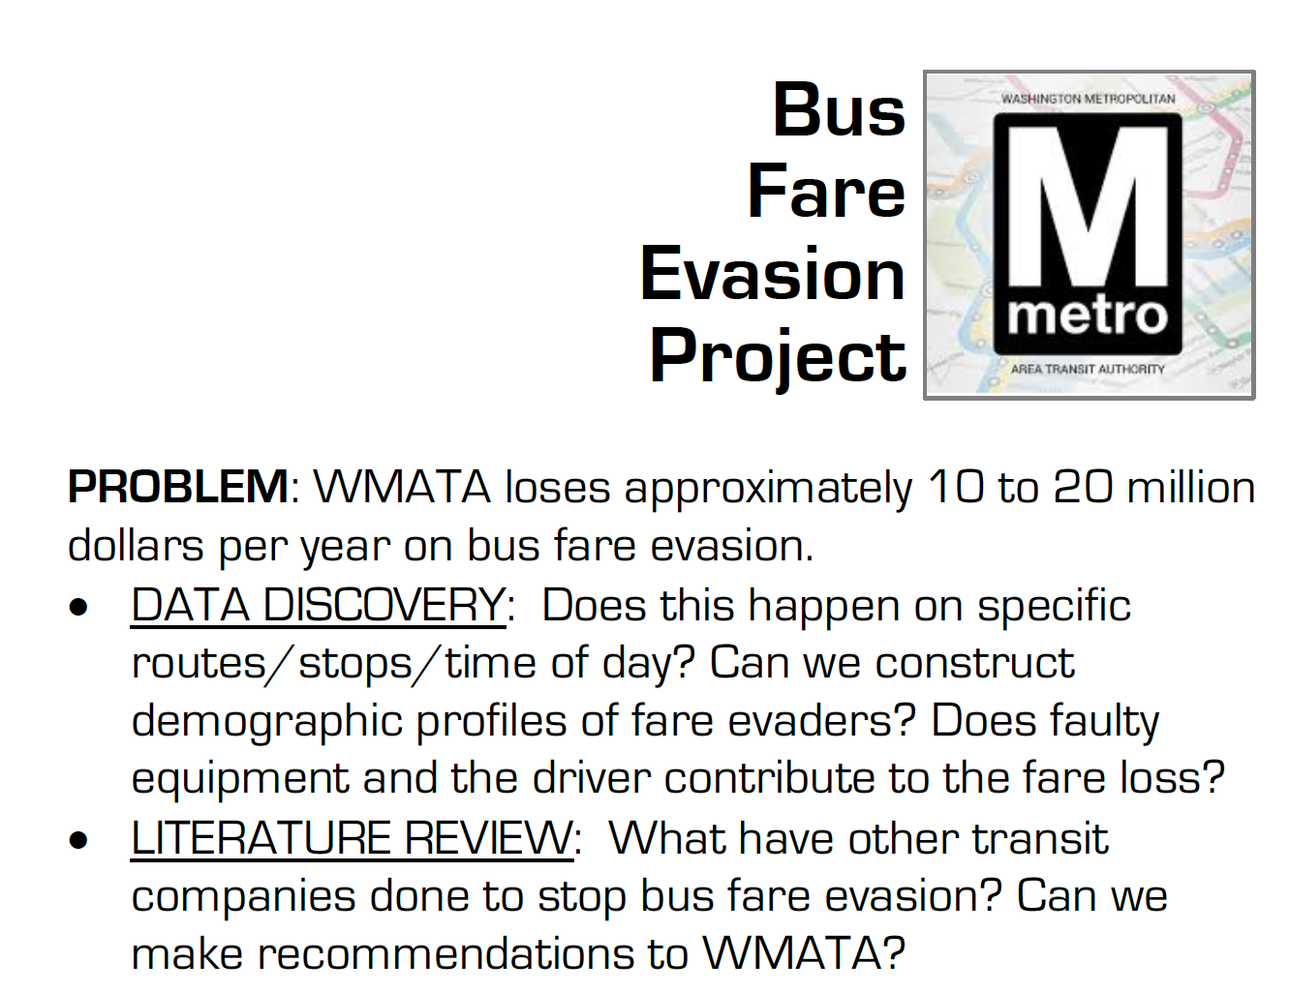

Slide 49
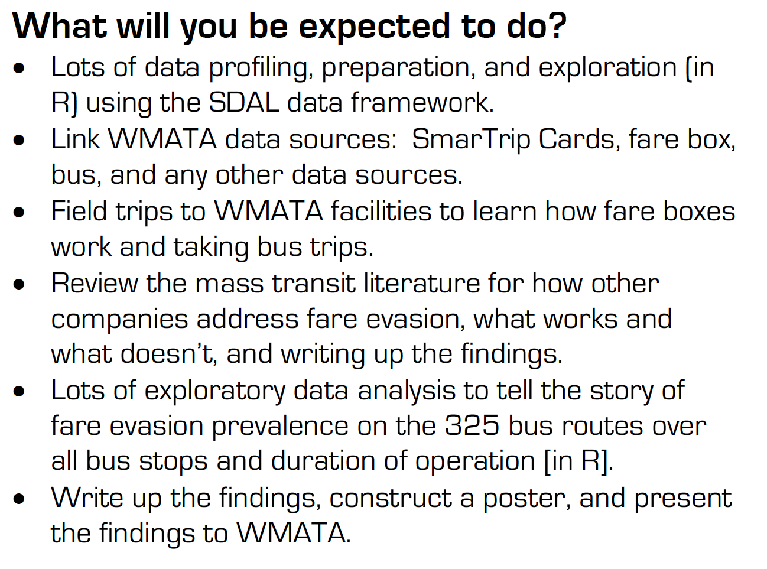

Slide 50

Repurposing 911 Data toward Evidence-Based Policy
PI & Co-PI: Gizem Korkmaz & Josh Goldstein
Team: Aaron Schroeder, Dave Higdon, Madison Arnsbarger
Sponsor: Arlington County Police and Fire Departments

Slide 51
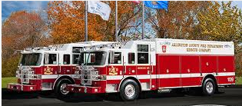
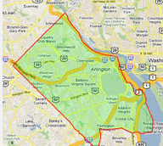

Project Overview
Situational Awareness: to improve quality of life and services while accelerating the county’s efficiency and resiliency

Slide 52
Research Questions
What is the impact of the actions / programs / campaigns established by law enforcement?
What to expect from specific events so that they can be better prepared?
Criminal networks and repeated offenders in Arlington
Which factors affect emergency response time?
Predicting houses in need of police

Slide 53
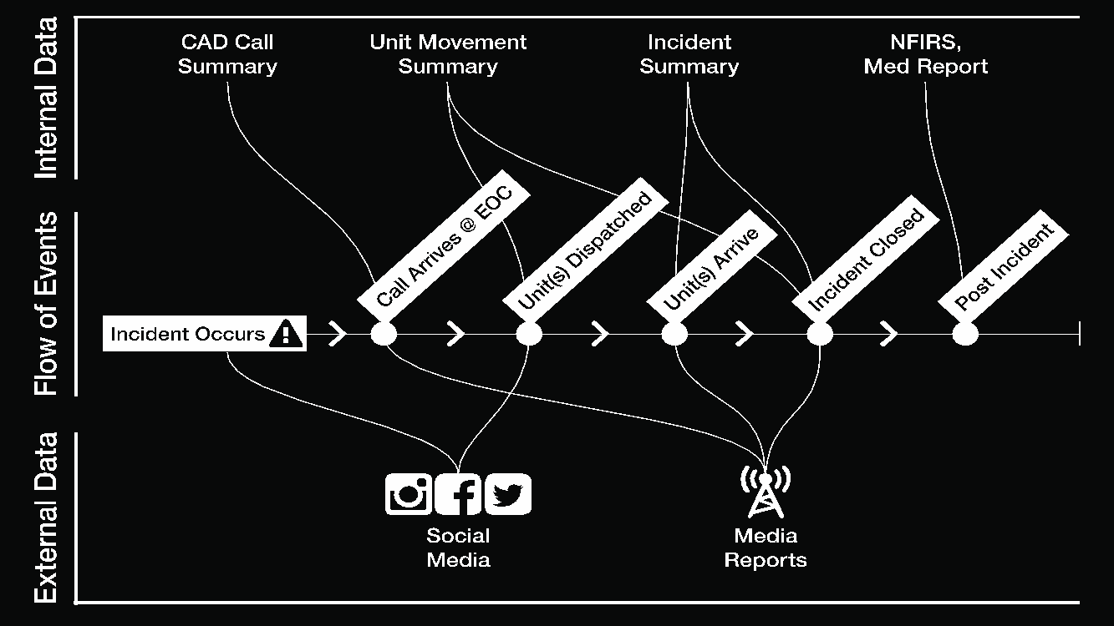


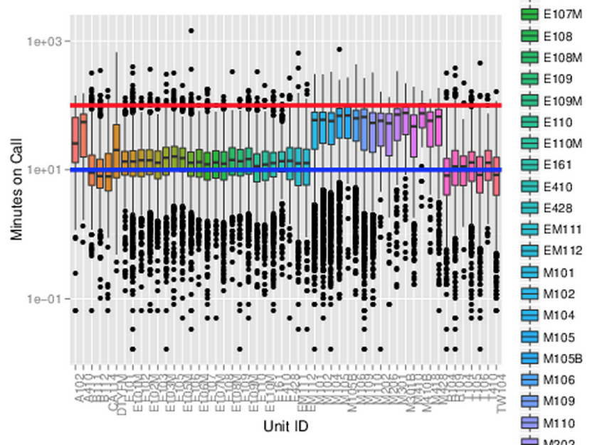
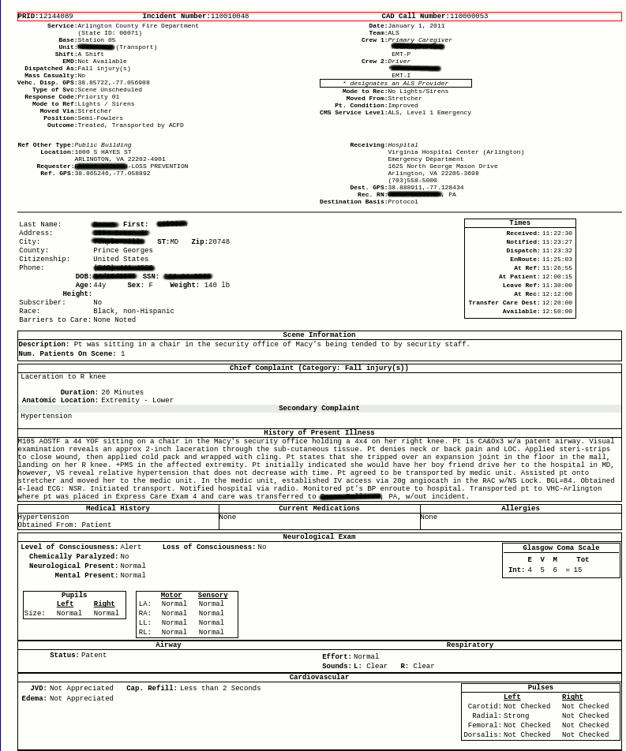

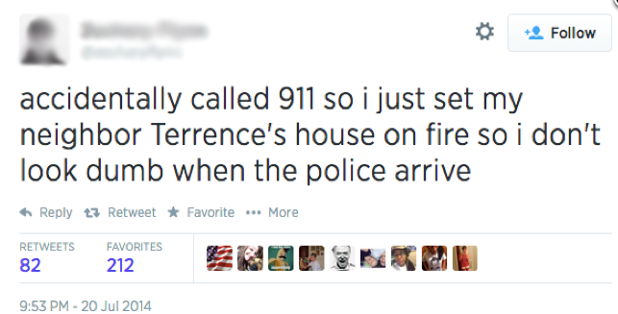

Slide 54
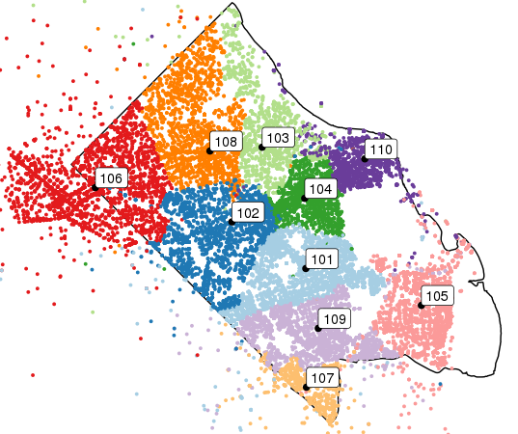
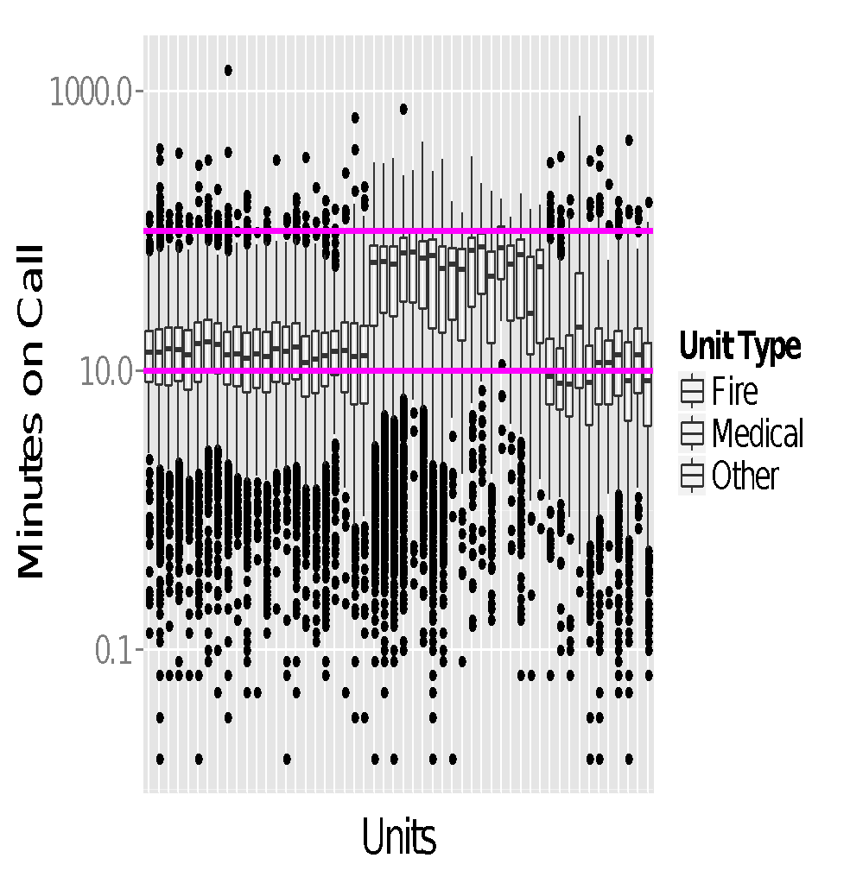
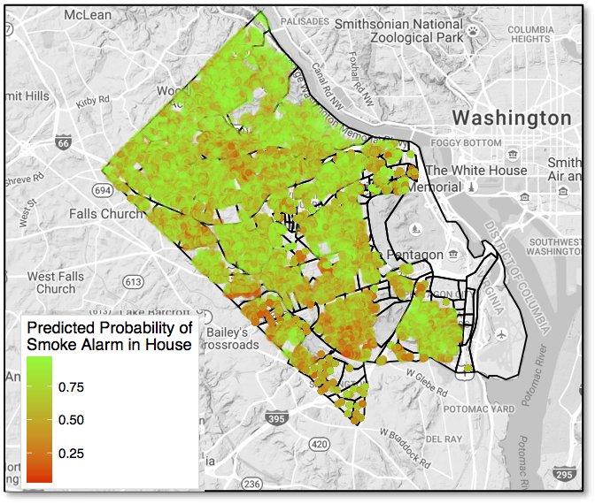
Project Goals & Deliverables
Exploratory Analysis of 911 Fire/Emergency and Incident Data
External data collection (ACS, housing transportation, weather, events, holidays, festivals, ACPD social media accounts, …)
Statistical Analysis and Modeling

Slide 55
Data Federation for Human Service Client Characterization
PI & Co-PI: Aaron Schroeder & Mark Orr
Sponsor: Department of Human Services, Arlington County

Slide 56



Project Overview
Arlington DHS has a 'no wrong door' philosophy meaning customers can sign-up for any DHS service from any DHS department
Data collected from multiple locations into different systems
Arlington DHS client data is managed in multiple systems
their own
those provided by the Commonwealth of Virginia
those provided by the Federal Government
Depending on the type of data collected, different Privacy laws apply
FERPA (Family Educational Rights and Privacy Act)
HIPAA (Health Insurance Portability and Accountability Act)
Something seemingly simple, Characterizing DHS Clients, is NOT

Slide 57
Research Questions
In identifying and describing DHS customers, we will seek to repurpose DHS administrative datasets to answer the following questions:
On any given day, how many customers is DHS serving?
What are the demographics of the customers that they are serving?
How does the daily distribution of customer compare with overall county demographics?
What subpopulations may be emerging as new pockets of needed services?
What eligible individuals may be being missed by DHS services?
Answers to these questions will help DHS align resources and needed services, as well as target further outreach.

Slide 58
Project Goals & Deliverables
Demonstrate Probabilistic Data Federation between two DHS systems not typically linked (e.g. State and Local Systems)
Demonstrate PRIVACY PROTECTED Probabilistic Data Federation between two DHS systems not allowed to link (e.g. Systems protected by different privacy laws)
Profile and prepare linked data sets for exploration
Characterize Human Service Clients in a way that has never been done before!

Slide 59
How many people on the beach?
PI: Dave Higdon
Sponsor: City of San Diego Lifeguards

Slide 60
How many people on the beach?
They want to estimate how many people use the beach on a given day.
Would like the estimation approach to be easy, but relatively accurate
They have 7 different beaches they need the counts for
One approach, use photos taken from the main lifeguard station to estimate how many people are on the beach at the time the photo was taken.
Would like to use machine learning methods to:
Count number of people in the identified region
Automatically identify an area over which to count people
Given the region and the count, provide an estimate of the total on the beach.
How do we use ML (or other analytics) to count people in the photo?
How many photos are required?
How much training is needed for ML approach to work?
Can we make an app that automatically does this, producing a crowd estimate (with uncertainty bounds)?

Slide 61
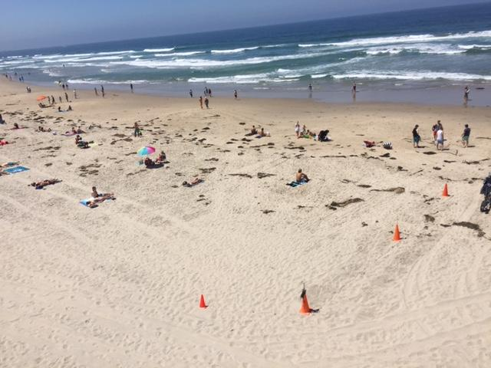
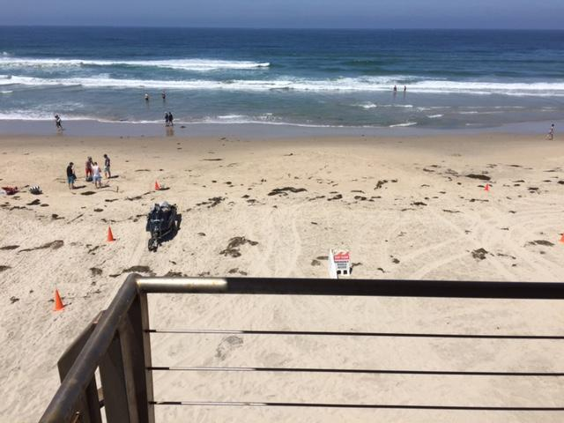
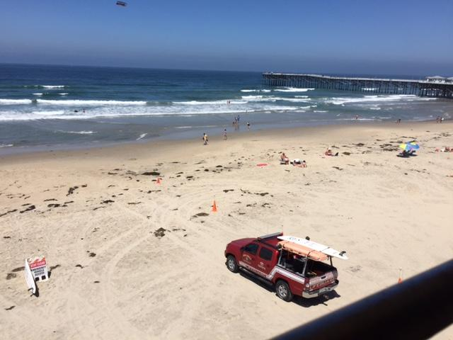
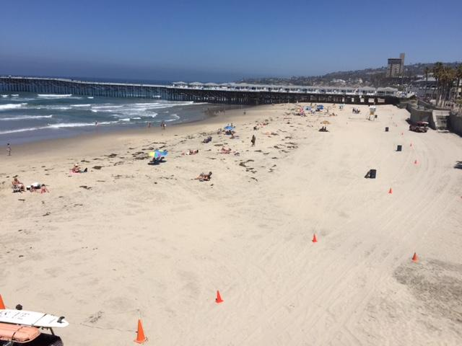
Photos from main PB tower
Will have additional times of day to use as a ground truth
Aaron, show the drone movie!

Slide 62
Now tell us which projects you’d like to work on this summer!

Slide 63
Tips & Instructions
Read the ‘Project Descriptions’ in the Google Drive Shared Folder
Talk to Project PI’s & Co-PI’s for more information
Send an email to Gizem Korkmaz (gkorkmaz@vt.edu) & Aaron Schroeder (aschroed@vt.edu) indicating:
- top 5 project choices
- level of R (and other language) skills (none/low/medium/high)
by 9AM tomorrow, sooner the better!
Talk to Gizem & Aaron for suggestions, Offices 3-010 & 3-030
You will be assigned projects and mentors tomorrow!

Slide 64
Projects
DSPG Group Project – Community Profiles & Indicators
Alexandria
Arlington
Fairfax
New Kent
Roanoke
NSF NCSES Projects
Open Source Software (OSS)
Business Innovation
STEM Education
Army Research Institute (ARI)
State Council of Higher Education for Virginia (SCHEV)
Washington Metropolitan Area Transit (WMATA) Project
Arlington County Projects
Public Safety 911: Police and Fire Departments (AC 911)
Department of Human Services (DHS)
The Beach

